Slide 1

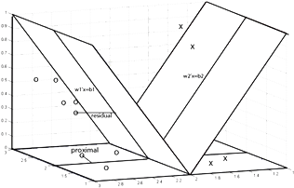
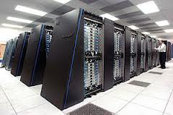


Supervised Learning Classification (Prediction Modelling)
Taufik Sutanto taufik.sutanto@uinjkt.ac.id

Slide 2
Outline
Decision Tree
Logistic Regression
Neural network
k-Nearest Neighbour

Slide 3
Predictive Modelling: What is it?
Similar to the human learning experience
Uses observations to form a model of the important characteristics of a phenomenon.
Uses generalizations to fit new data into a general framework.
It is a supervised learning approach.
Due to the presence of target variable (or class labels) in past observations.
Analyzes a dataset to determine essential characteristics in the presence of a target.
Applications
customer retention management, credit approval, Medical diagnosis, and direct marketing.

Slide 4
Predictive Modeling: 3 Step Process
1. Model Construction /Training/Learning:
Each instance is assumed to belong to a predefined class, called the target or class label
The set of all records used for construction of the model is called training set
The model is usually represented in the form of classification rules, (IF-THEN statements) or decision trees or neural networks
2. Model Evaluation/Testing:
Estimate accuracy rate of the model based on a test/ validation set
Accuracy rate is the percentage of test set samples that are correctly classified by the model
3. Model Use:
The model is used to classify unseen instances, i.e. assign the class labels

Slide 5
A Sample Data set
Inputs/Variables/Attributes/
Target
...
...
...
...
...
...
Cases/Instances/Records
...
...
...
.
.
.
.
.
.
.
.
.
.
.
.
.
.
.
.
.
.
.
.
.
.
.
.
.
.
.
.
.
.
.
.
.
...
...
...

Slide 6
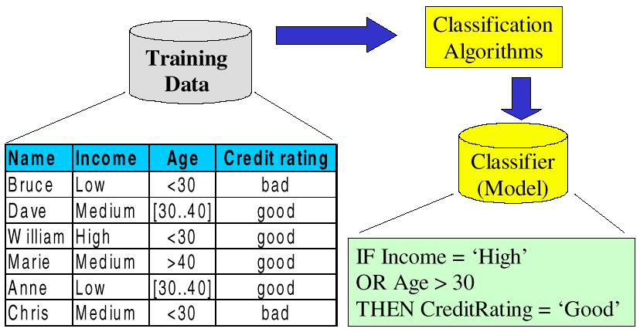
Training: Model Construction

Slide 7
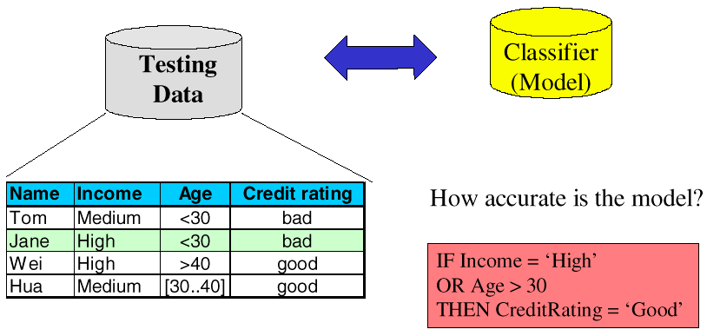
Testing: Model Evaluation

Slide 8
Choosing the best model
Several models are built for 1 classification task.
Using several subsets of dataset
Using several sets of features
Using several algorithms
Several parameters
Which one to use for predictions?
Estimate accuracy of the model
The known label of test sample is compared with the classified result from the model
Accuracy rate is the percentage of test set samples that are correctly classified by the model
Test set is independent of training set, otherwise over-fitting may occur

Slide 9
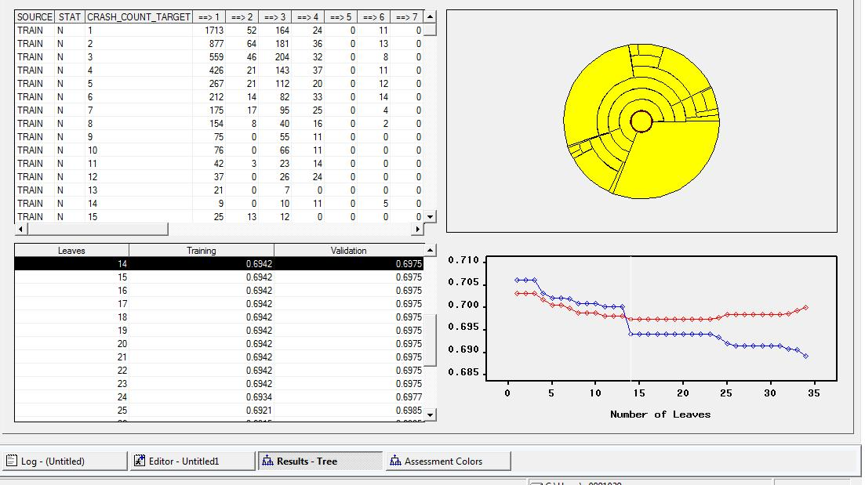
Overfitting: An Example

Slide 10
Overfitting
Training Set
Test Set

Slide 11
Better Fitting
Training Set
Test Set

Slide 12
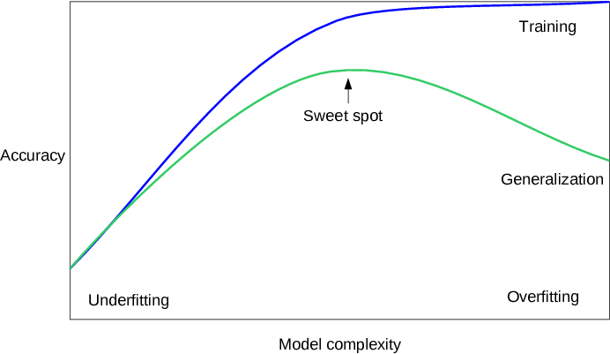

Slide 13
Classification: An Example
Learn a method for predicting the instance class from the pre-labeled instances
Each point is a multi-dimensional instance that includes several attributes.
Given a set of points from classes Red and Purple
What is the class of new point ?

Slide 14
Classification: Decision Trees
if X > 5 then Red
else if Y > 3 then Red
else if X > 2 then Purple
else Red
Y
piecewise constant approximation of decision regions
Symbolic if-then rules
linear/non-linear, continuous/categorical model of decision regions
3
2
5
X

Slide 15
Classification: Neural Nets
linear/non-linear, continuous/categorical model of decision regions
a number of parameters such as set of weight matrices
Can select more complex regions
Can be more accurate
Also can overfit the data – find patterns in random noise

Slide 16
Classification: Nearest Neighbor
Does not make a model
localised decision regions from data
a metric space based on proximity - calculates distance between the query point and data points
Chooses nearest neighbors and makes decisions based on neighbors outcome
Sensitive to data errors

Slide 17
Classification: Logistic Regression
Linear Regression
w₀ + w₁ x + w₂ y >=0
Regression computes wi from data to minimize squared error to ‘fit’ the data
Not flexible enough

Slide 18
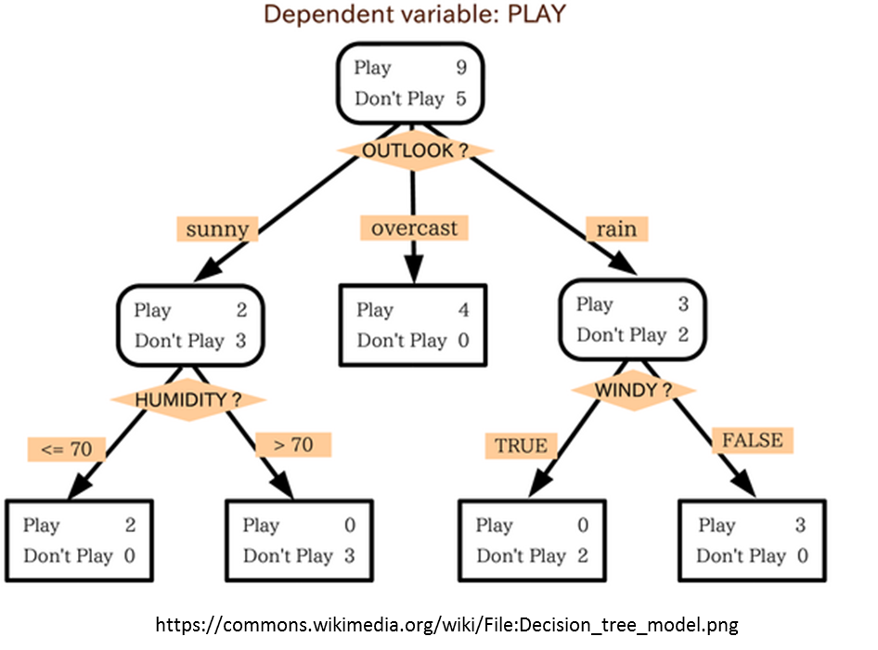
What is a Decision Tree?
Notes:
Hierarchy of Boolean logics

Slide 19
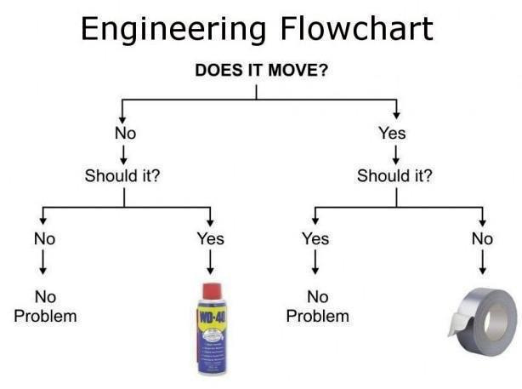
A famous (easy to understand) example of a decision tree:
https://www.flickr.com/photos/dullhunk/7214525854
Notes:
☺

Slide 20
Applications
Manufacturing
PC board failures: which components are problematic?
Medical
If patient has a reaction, what are the traits of those patients?
Financial
Credit card fraud detectiont scoring
Marketing
Churn prediction models

Slide 21
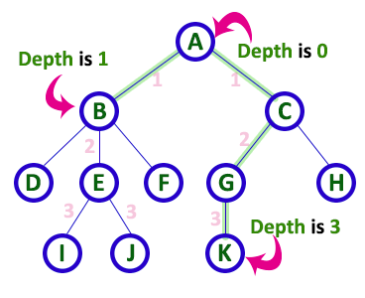
Tree Structure basic terminology
Root
Level 0
Internal nodes
Level 1
Leave Node
Level 2
Level 3
http://btechsmartclass.com/DS/U3_T1.html
Depth of tree = Max depth of nodes

Slide 22
Decision Tree Classifier
When to use:
Target : Binomial/nominal.
Predictors (input): binomial, nominal, and-or interval (ratio).
Advantage:
Fast and embarrassingly parallel.
No iteration ➔ suitable for some Big Data technology (e.g. Hadoop) [map-reduce friendly]
Interpretability
Robust to outliers
Disadvantage:
Non probabilistic (ad hoc heuristic) : can be a good/bad thing.
Target with many classes
Sensitive (instability)

Slide 23
Brief History of Decision Tree in Datamining
AID : first brought into in the 1960’s
CHAID – Kass 1980. Grows until some goodness of split criterion is met.; Uses Chi-Square methodology
ID3 : Ross Quinlan (1986). Nominal predictors. Entropy, Information gain.
Enterprise Miner (SAS): Has a C&RT, Chaid and a mix of the two in it.
Answer Tree (SPSS): Has a C&RT and Chaid in it
CART [Minitab acquire Salford System 06/03/2017]
Overfit and then prunes back; Handling of missing values.
C4.5: Ross Quinlan (1993). Handling both continuous and discrete predictors.
Using information gain to select the most discriminatory feature (for tree & sub-trees)
C5.0 : Ross Quinlan: More efficient memory & computation. Support winnow & boosting.
Random Forest : Ho, Tin Kam (1995), coined by Leo Breiman (2001),. Uses an ensemble approach of decision trees. feature bagging.

Slide 24
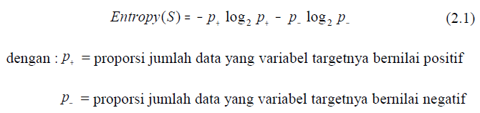
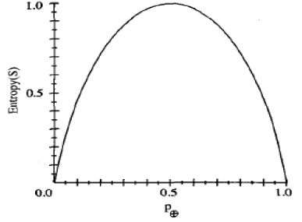
Dasar Pohon Keputusan 1 ENTROPI

Slide 25
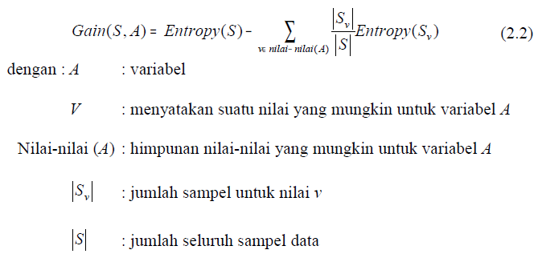
Dasar Pohon Keputusan 1 INFORMATION GAIN

Slide 26
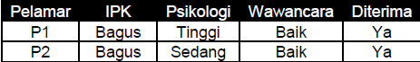
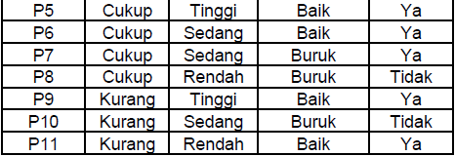
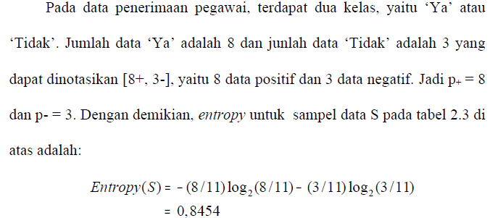
CONTOH

Slide 27
Example on calculating Entropy and Information gain
Id | Target | X1
1 | 0 | a
2 | 1 | b
3 | 1 | b
4 | 1 | b
5 | 1 | a
6 | 0 | b
P+ = Proportion of observation with positive class
P- = = Proportion of observation with negative class
0 = 2 [positive]
1 = 4 [negatives]
Then Entropy (S) = -2/6 log2 (2/6) – 4/6 log2 (4/6)
~ 0.277
Gain (S, X1) = 0.277 – (2/6)(0) -(4/6)(0.244)
= 0.114
Repeat for other predictors : X2, X3, …
Complete Example:
http://www.saedsayad.com/decision_tree.htm

Slide 28
Why –p log(p) ? Information Theory (from slides of Tom Carter, June 2011) Quoted from OCW MIT OpenCourse

Slide 29
Why –p log(p) ? Information Theory (from slides of Tom Carter, June 2011) Quoted from OCW MIT OpenCourse

Slide 30
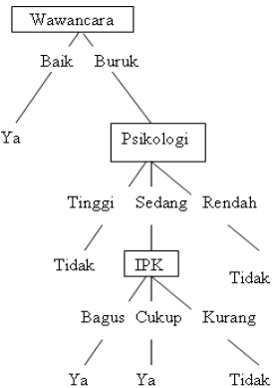
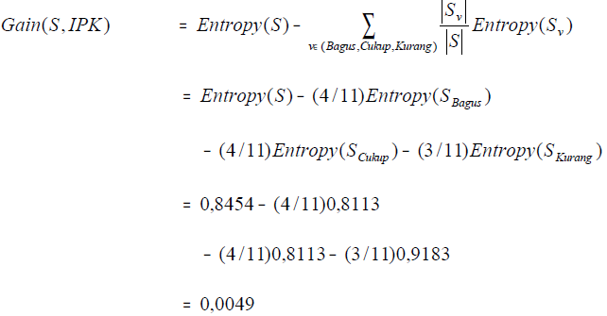
CONTOH

Slide 31
Tips: Not all terminal Nodes in a Decision Tree are “useful” (Tree Map-Leaf Stat)

Slide 32
Logistic Regression

Slide 33

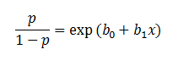
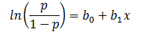
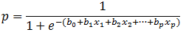
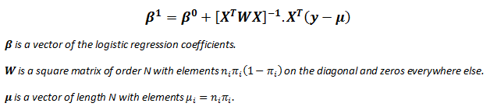
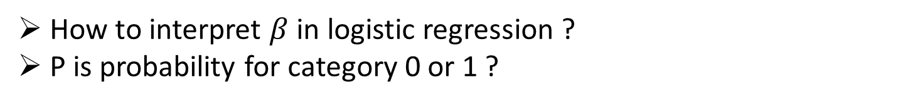
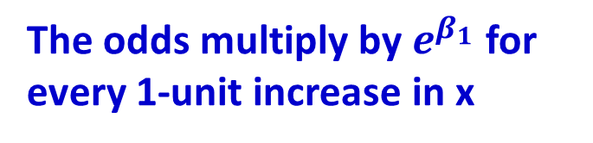
From Regression to Logistic Regression
Odds
http://www.saedsayad.com/logistic_regression.htm
The odds multiply by $e^{β_{1}}$ for every 1-unit increase in x
How to interpret $β$in logistic regression ?
P is probability for category 0 or 1 ?

Slide 34
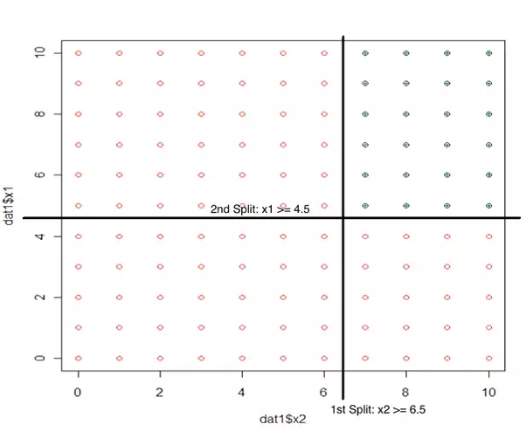
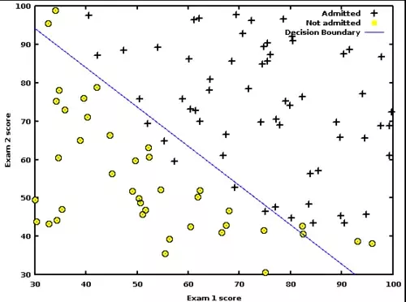
Assumptions: Decision Tree VS Logistic Regression
“Decision boundaries are parallel to the axes”
“There is one smooth linear decision boundary”
https://www.quora.com/What-are-the-advantages-of-logistic-regression-over-decision-trees
Notes:
> Explain why DT used a lot in marketing , the assumption holds well

Slide 35
“Pseudo” R²
http://www.saedsayad.com/logistic_regression.htm

Slide 36
Logistic Linear Regression
When to use:
Target : binary
Predictors (input): numeric or categorical.
Advantage:
Robust (distribution assumption and heteroskedasticity)
scientific acceptance (Strong theoretical framework)
less prone to over-fitting (compared to Decision Tree ➔ why?)
Considerably fast (Matrix Operations ➔ why?)
Disadvantage:
Requires more data to achieve stable and meaningful results.
Restricted binary response (binary logistic)
Missing values
Notes:
Logistic regression is intrinsically simple, it has low variance and so is less prone to over-fitting.

Slide 37
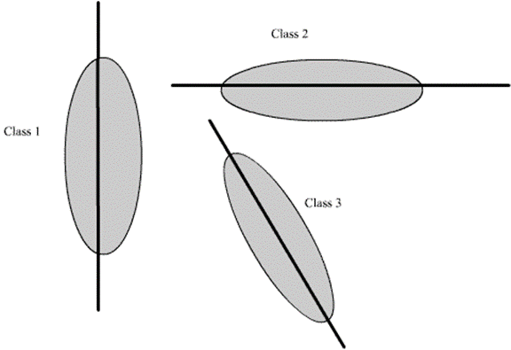
Multiclass Classification – One Versus All (OVA) Approach
Notes:
> Weak classifier

Slide 38
Analyzing Logistic Regression outputs
“Already” odds ratio
Categorical Variables have baseline
Notes:
> If X increase 1 unit, the odds ratio is multiplied by the point estimate values …

Slide 39
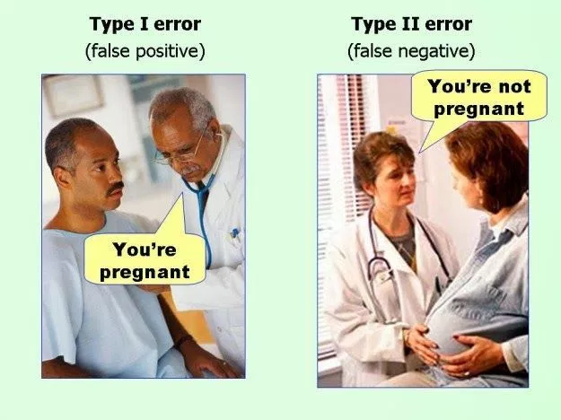
Analyzing Binary classifiers outputs

Slide 40
Discussions
Unlike decision tree, regression does not accept missing values. Why?
Kalau akurasi regresi logistic mirip dengan decision tree, model manakah yang akan anda gunakan?
Notes:
Depend on the application, sometimes a slight improvement is meaningful. In other case, interpretability is more important.
Depend on the objective of the modelling: When our objective is to see “variable importance” ➔ standardize. But this will make interpretability more difficult.

Slide 41
Neural Network

Slide 42

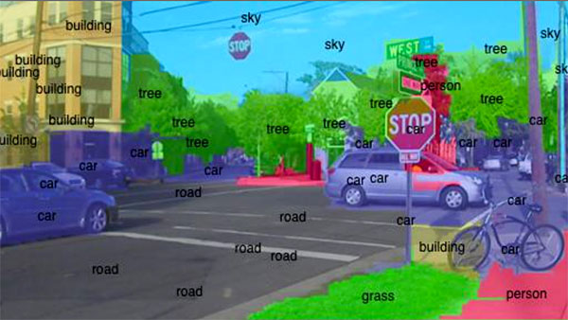
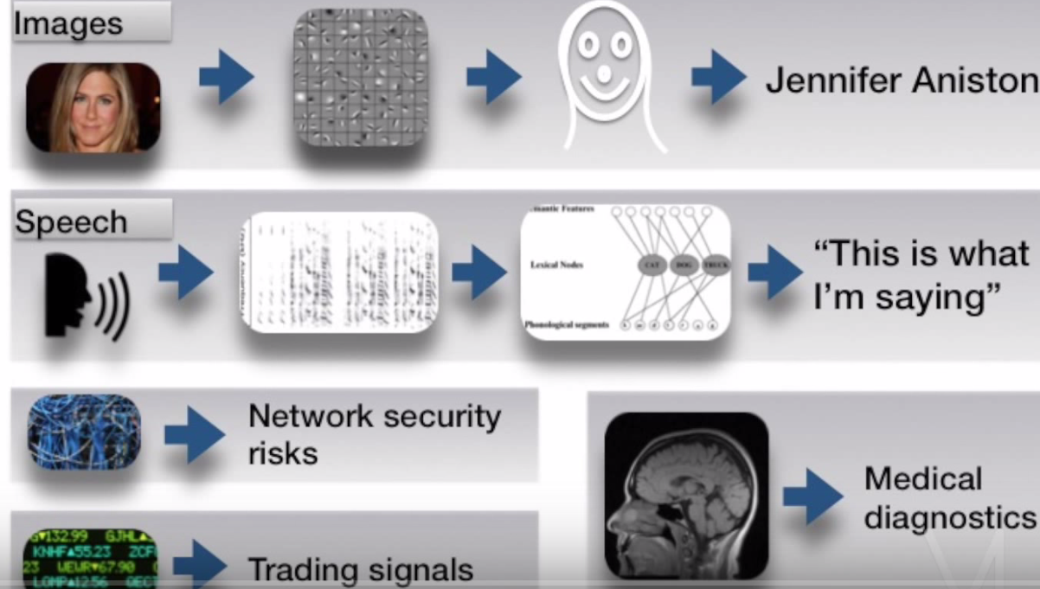
Currently (very) popular
http://artificialbrain.xyz/introduction-to-deep-learning-with-python/
https://engineering.purdue.edu/EngineeringImpact/2014_1/smartphone-to-become-smarter-with-deep-learning-innovation
http://www.nextbigfuture.com/2016/03/what-is-different-about-alphago-versus.html

Slide 43
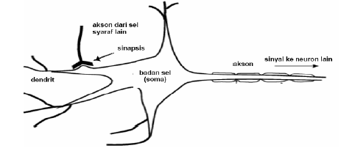
Jaringan Saraf Manusia
Jaringan saraf buatan merupakan model yang cara kerjanya meniru sistem jaringan biologis. Otak manusia terdiri atas sel-sel saraf yang disebut neuron, yang berjumlah sekitar 10¹¹ sel-sel saraf. Sel-sel saraf ini berhubungan satu dengan yang lain membentuk jaringan yang disebut jaringan saraf

Slide 44
Jaringan Saraf Buatan
Jaringan saraf buatan diperkenalkan pertama kali pada tahun 1943 oleh seorang ahli saraf Warren McCulloch dan seorang ahli logika Walter Pitss .
jaringan saraf buatan adalah sebuah sistem yang dibentuk dari sejumlah elemen pemroses sederhana yang bekerja secara paralel dan fungsinya ditentukan oleh stuktur jaringan, kekuatan hubungan serta pengolahan dilakukan pada komputasi elemen-elemennya.

Slide 45
Artificial Neural Networks
Neuron (Human Brain)
Output
Inputs
synapses
Simulated Neural Network Node or Unit
Output
Inputs
weight

Slide 46
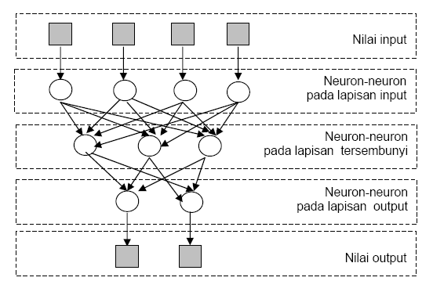
Arsitektur Jaringan Saraf Buatan
Sistem saraf buatan terdiri dari tiga lapisan unit, yaitu:
Unit input
Unit tersembunyi
Unit output
X₁
X₂
X₃
X₄
i₁
i₂
i₃
i₄
h₁
h₂
h₃
o₁
o₂
Y₁
Y₂

Slide 47
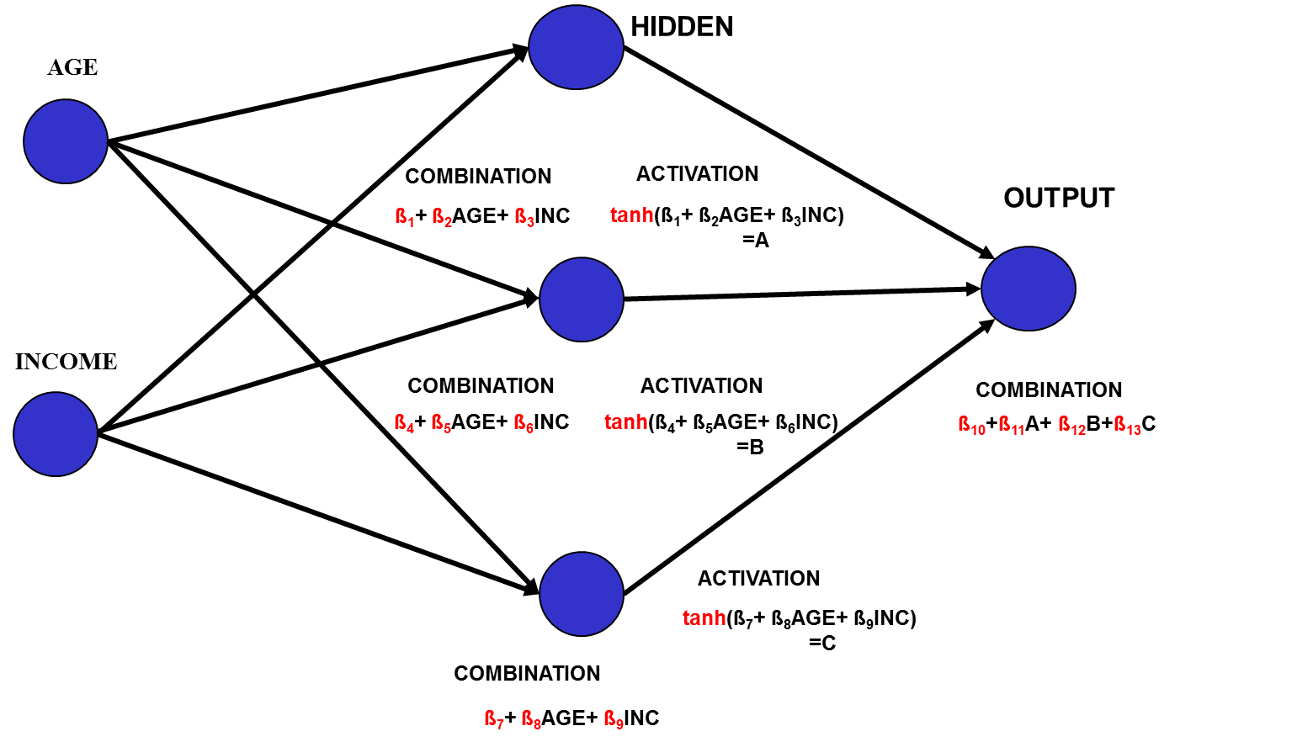
Neural Network
Input Layer
Hidden Layer
Output Layer
Not
Neurons
Neurons
Synapse
(weights)

Slide 48
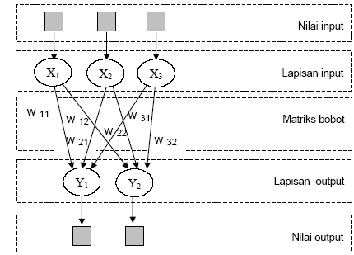
Jaringan dengan lapisan tunggal
Jaringan dengan lapisan tunggal hanya memiliki satu lapisan dengan bobot yang terhubung. Jaringan ini hanya menerima input kemudian secara langsung akan mengolahnya menjadi output tanpa harus melalui lapisan tersembunyi

Slide 49
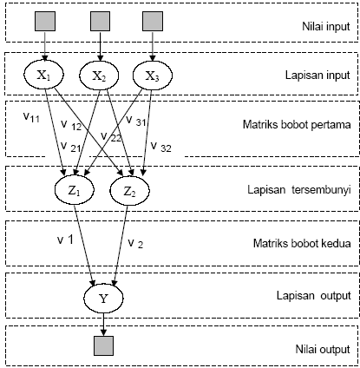
Jaringan dengan lapisan banyak
Pada tipe ini, diantara lapisan masukan dan keluaran terdapat satu atau lebih lapisan tersembunyi

Slide 50
Multilayer Perceptron
Hidden Layers
weights
Output Layer
Input
Layer
Output Node
Hidden Node
Input Node

Slide 51
Perceptron
Salah satu tipe dari sistem jaringan saraf buatan didasarkan pada sebuah unit yang disebut perceptron, dan diilustrasikan pada gambar 2.8. Sebuah perceptron menerima vektor input yang berupa nilai bilangan real. Perceptron memiliki perhitungan kombinasi linear yang berasal dari penjumlahan vektor input , vektor bobot dan nilai thresholdnya (w₀). Hasil output akan bernilai 1 jika perhitungan kombinasi linearnya lebih besar dari pada 0 dan -1 jika perhitungan kombinasi linearnya lebih kecil atau sama dengan 0.
o(x₁, x₂, ......., x_{n}) =

Slide 52
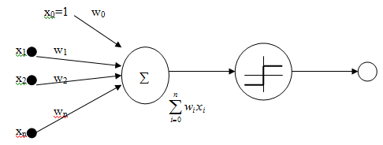
Perceptron
o(x₁, x₂, ......., x_{n}) =

Slide 53
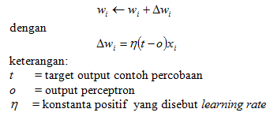
Aturan Pembelajaran Perceptron
Salah satu cara untuk mempelajari vektor bobot yang tepat yaitu dimulai dengan penentuan bobot secara acak, kemudian secara iteratif dengan menggunakan perceptron untuk menghasilkan output pada setiap contoh percobaan, setelah itu memodifikasikan bobot perceptron. Proses ini terus diulang sampai pengklasifikasian perceptron untuk semua contoh percobaan menjadi tepat.

Slide 54
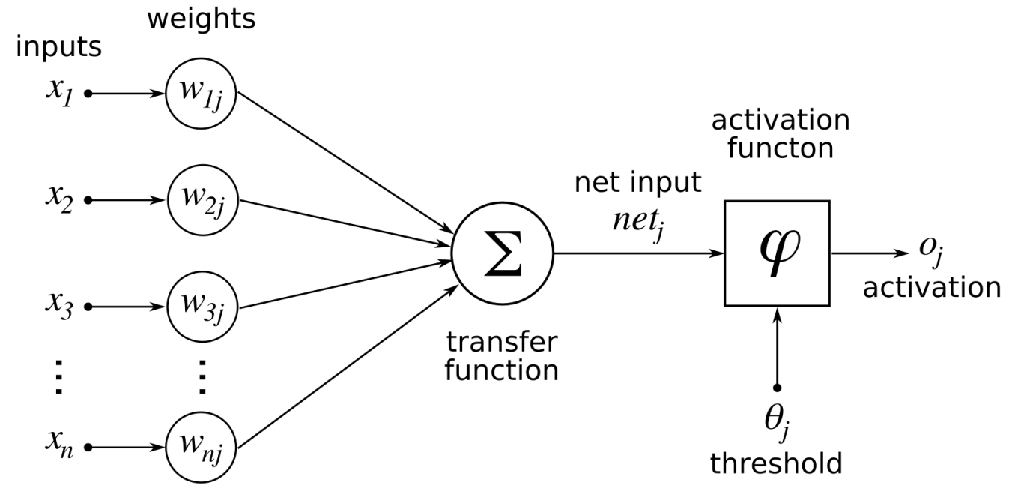
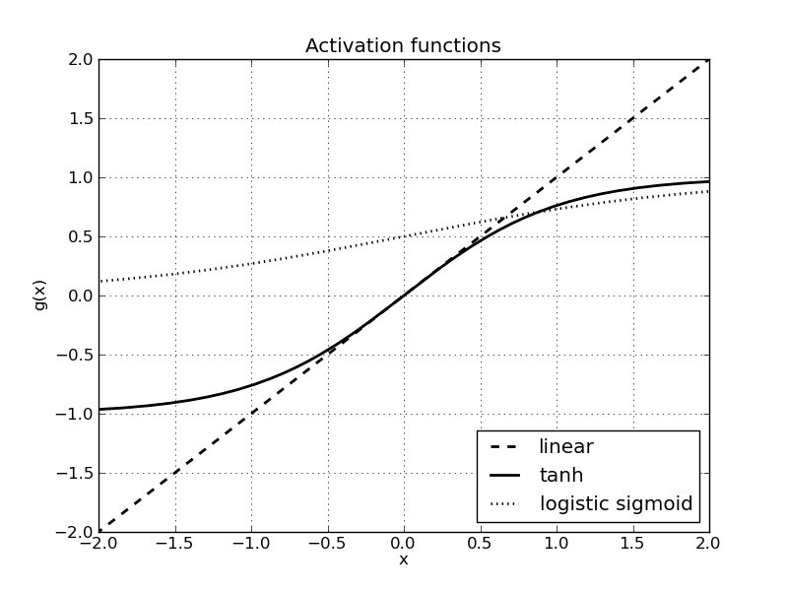
Activation Function
@https://en.wikibooks.org/wiki/Artificial_Neural_Networks/Activation_Functions

Slide 55
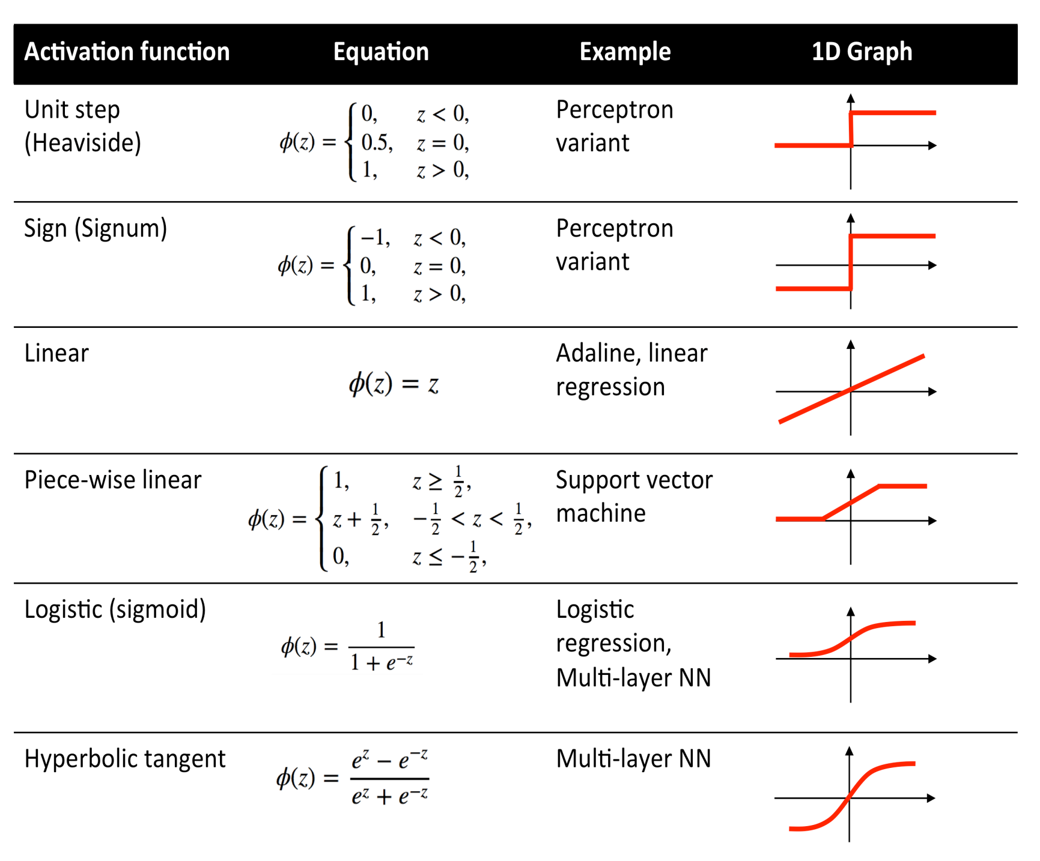
@http://pypr.sourceforge.net/ann.html

Slide 56
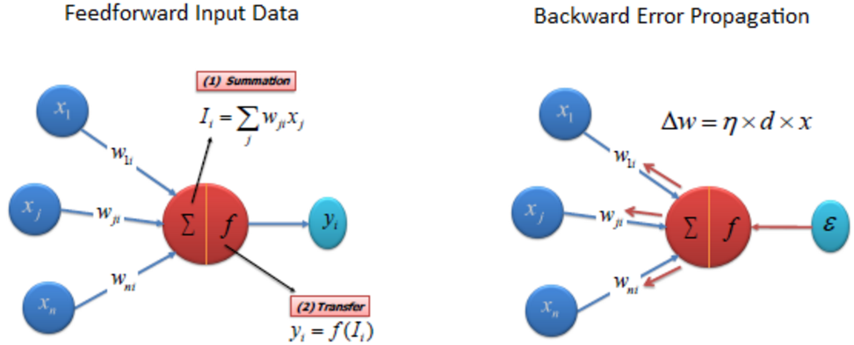
How does it work? [A simple example]
+ b
http://www.saedsayad.com/artificial_neural_network.htm
Initialize all Weights (connection strength) & Biases. (values are random, usually -0.05~0.05 )
Iterative process of forward and then backward (revision of the weights).
Each node sums the values it receives & then modifies it based on a transfer function f(I)
The activation flows through the hidden layers, until it reaches the output nodes.
The difference between predicted and actual value (error) will be propagated backward to update the weights.

Slide 57
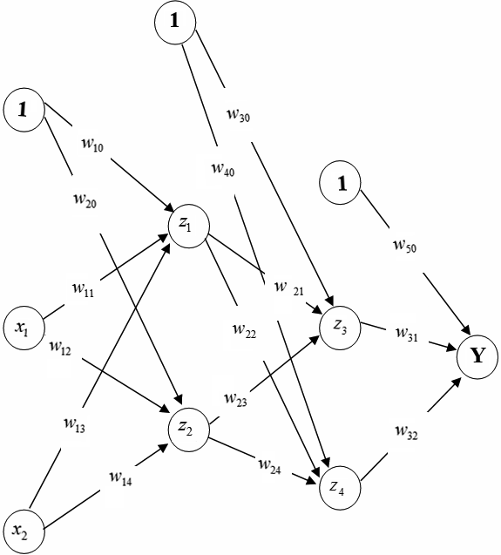
A simple example: Back Propagation
Extra Nodes for Bias Θ
0.02
-0.03
Step 1 : Initialize all Weights & Biases
Step 2: Using the first observation X₁=1, X₂=1 Calculate Sums
0.01
0.04
0.05
0.03
0.05
0.03
1
-0.01
0.09
-0.04
-0.05
0.04
0.03
0.05
-0.03
-0.02
0.05
1
0.05

Slide 58
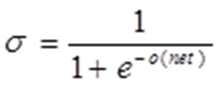
A simple example: Back Propagation
0.02
-0.03
Step 3 : Calculate Sigmoid(σ) in all nodes
0.51
0.01
0.04
0.05
0.03
0.05
0.03
0.52
1
-0.01
0.09
-0.04
-0.05
0.49
0.04
0.03
0.51
0.05
-0.03
-0.02
0.05
1
0.05

Slide 59
A simple example: Back Propagation
0.02
-0.03
Step 4 : Calculate Sum & Sigmoid(σ) in output nodes
0.51
0.01
0.04
0.05
0.03
0.05
0.03
0.52
1
0.0347
-0.01
0.09
-0.04
-0.05
0.49
0.5
0.04
0.03
0.51
0.05
-0.03
-0.02
0.05
1
0.05

Slide 60
A simple example: Back Propagation
0.02
-0.03
Step 4 : Calculate Error
0.51
0.01
0.04
is Error value that will be used to update weights
0.05
0.03
is Output value and t_{k} is Observed value
0.05
0.03
0.52
1
0.0347
-0.01
0.09
-0.04
-0.05
0.49
0.5
0.04
-0.125
0.03
0.51
0.05
-0.03
-0.02
0.05
1
0.05

Slide 61
A simple example: Back Propagation
0.02
-0.03
Step 5 : Calculate Delta Rule (sums error) in hidden nodes
0.51
0.01
0.04
0.05
0.03
0.0004
0.05
0.03
0.52
1
-0.002
0.0347
-0.01
0.09
-0.04
-0.05
-0.001
0.005
0.49
0.5
0.04
-0.125
0.03
0.51
0.05
-0.03
-0.006
-0.02
0.002
0.05
0.011
1
0.05
0.001

Slide 62
A simple example: Back Propagation
0.02
-0.03
Step 6 : Calculate Weights Correction factors [η: learning rate, assume η = 0.05]
0.51
0.01
0.04
0.05
0.03
0.0004
0.05
0.03
0.52
1
-0.002
0.0347
-0.01
0.09
-0.04
-0.05
-0.001
0.005
0.49
0.5
0.04
-0.125
0.03
0.51
0.05
-0.03
-0.006
-0.02
0.002
0.05
0.011
1
0.05
0.001

Slide 63
A simple example: Back Propagation
0.02
-0.03
Step 7 : Update the Weights
0.51
0.01
0.04
0.05
0.03
0.0004
0.05
0.03
0.52
1
-0.002
0.0347
-0.01
0.09
-0.04
-0.05
-0.001
0.005
0.49
0.5
0.04
-0.125
0.03
0.51
0.05
-0.03
-0.006
-0.02
0.002
0.05
0.011
1
0.05
0.001

Slide 64
A simple example: Back Propagation
0.02
-0.03
0.51
0.01
Step 9 : Do the same for all observations
[1 iteration (epoch) is when the calculations are done on all observations]
Step 10, 11, 12, …. Repeat until Convergence OR maximum iteration reached.
What is the convergence criteria? [discuss]
Why we need maximum iteration stopper? [discuss]
0.04
0.05
0.0024
0.0004
0.05
0.03
0.52
1
-0.002
0.0347
-0.01
0.09
-0.043
-0.05
-0.001
0.005
0.49
0.5
0.04
-0.125
0.03
0.51
0.0047
-0.03
-0.006
-0.02
0.002
0.05
0.011
1
0.05
0.001

Slide 65
Generalizing to multiclass classification

Slide 66
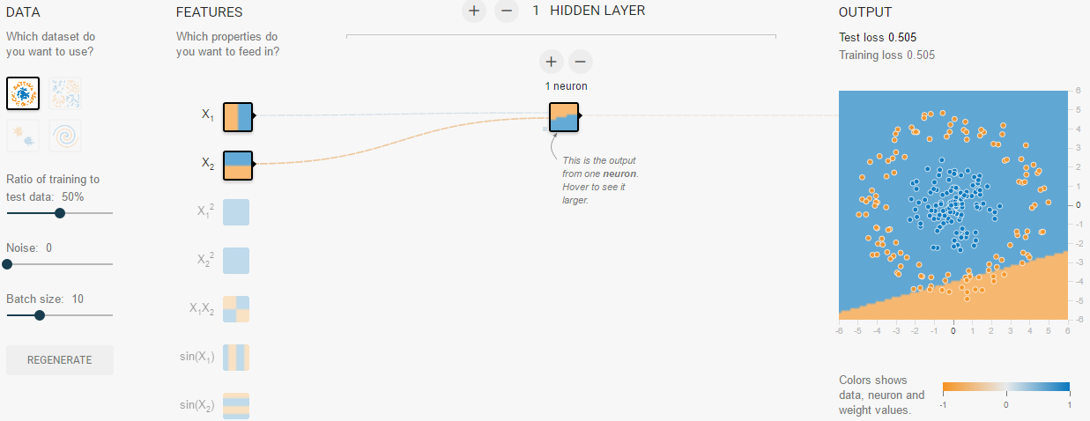
Let’s “Play” with a Neural Network Model
goo.gl/3rcnc9
Notes:
Understand the importance of number of units
What is epoch

Slide 67
How Neural Network found the non Linear boundary?
http://s.id/j6i
[±5” video]
Notes:
https://youtu.be/BR9h47Jtqyw?t=24m18s

Slide 68

http://www.asimovinstitute.org/neural-network-zoo/

Slide 69
Neural Network
When to use:
Target : Categorical (or numeric)
Predictors (input): numeric or categorical.
Advantage:
Works with large data: N>>>, L>>>>
High accuracy
Can handle missing values
Easily parallelize [A lot of GPU module support]
Disadvantage:
Interpretability
Non convex optimization (sometimes not convergent)
Converge to local optima.
Slow learning rate.

Slide 70
K – Nearest Neighbour

Slide 71
Instance-based representation
Simplest form of learning: rote learning or lazy learning or instance-based learning
Training instances are analyzed to identify the instance (or a set of instances) that most closely resembles the new (query) instance.
The instances themselves represent the knowledge.
A similarity function between the new instance and the data set instances defines what is “learned”.
The previous two modeling methods (decision tree and neural network) are called as Model-based learning.

Slide 72
Nearest Neighbour (k-NN)
Most commonly used instance-based predictive technique suitable for classification models.
The training data is not scanned or processed to create the model - the training data is the model!
When a new instance is presented to the model:
the algorithm looks at all the data to find a subset of k cases that are most similar to it, and
predicts the predominant outcome among the most similar cases in the training set, to the new case.

Slide 73
Nearest Neighbour (cont)
There are two principal drivers:
the number, k, of nearest cases to be used, and
a metric to measure what is meant by nearest.
The selection of k and the choice of a distance metric pose definite challenges, as there are no “correct” choices.
The model builder will need to build multiple models, validating each with independent test sets to determine which values are appropriate

Slide 74
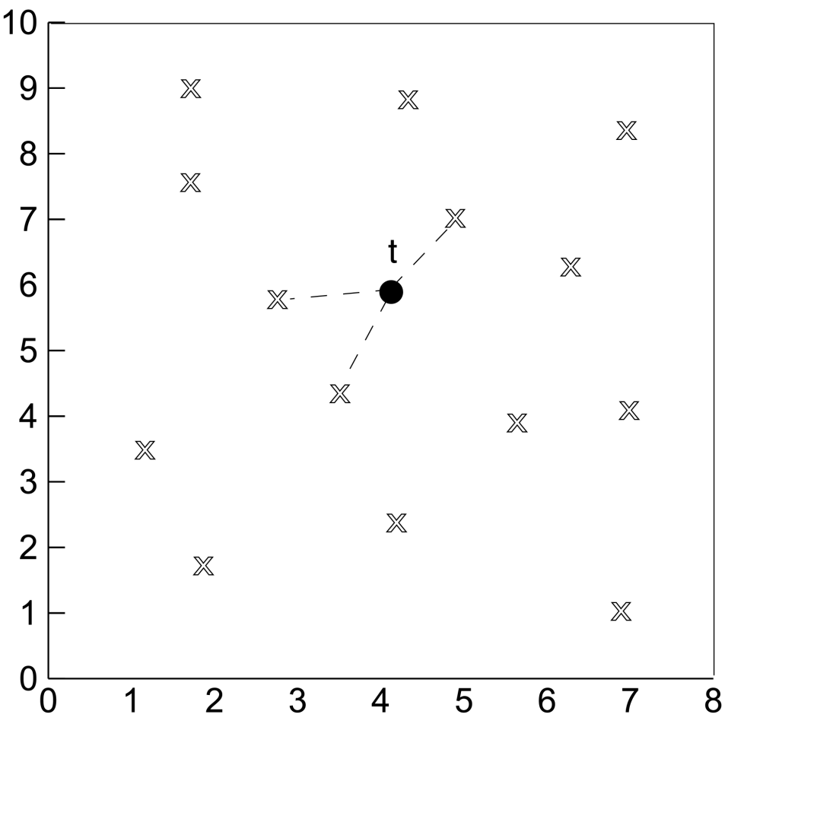
KNN (K- Nearest Neighbor)
t, new instance
without class labels
X, input instances
With class labels

Slide 75
Objects: Representation, Symbolic Mapping and Distance Calculation
large
1
Size
Large
small
0
0
Blue
1
red
Colour
blue
S1
Dot product
Sim(S1, S2) = 1*1+0*1=1
Sim(S1, S3) = 1*0 + 1.*0 = 0
Distance = 1/sim
1
[1,1]
Large
S3
S2
0
[0,0]
[1,0]
0
Blue
1

Slide 76
The distance function
Simplest case: one numeric attribute
Distance is the difference between two attribute values involved
Several numeric attributes: normally, Euclidean distance is used and attributes are normalized
a⁽¹⁾ and a⁽²⁾: two instances with k attributes
Nominal attributes: distance is set to 1 if values are different, 0 if they are equal

Slide 77
K-nearest neighbor classification
large
50
0
large
B
A
?
?
Size
Size
Averaging
Voting
20
B
40
10
100
B
A
B
small
small
red
blue
red
blue
Colour
Colour

Slide 78
A k-NN credit risk example
The Name column will be ignored because it is high unlikely that a person’s name affects his credit risk.
In the example, all the columns, except Name, have two possible values. The restriction to two values is only to keep the example simple.
We will use k=3, and for our distance measure we will use a simple metric that is computed by summing scores for each of the three independent columns, where the score for a column is 0 if the values in the two instances are the same, and 1 if they differ.
We can now compute the distance between Peter and Sue:
The three column scores for Peter and Sue are 1, 0, and 0 because they have different values only in the Debt column.
The distance between Peter and Sue – the sum of these scores – is equal to 1.

Slide 79
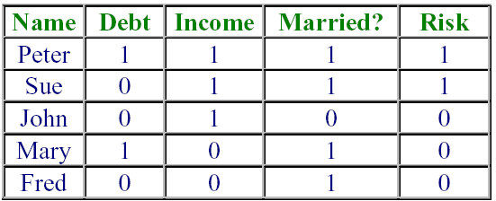
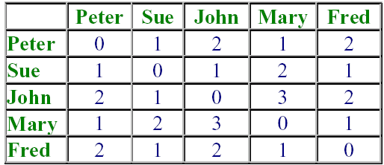
A k-NN credit risk example (cont)
Distance table summarises all the distances between all the records in the training dataset.
The three neighbours nearest to Peter are Peter, Sue and Mary, with risks Good, Good and Poor.
The predominant value is Good, which is the predicted risk for Peter.
Input Data
Distance Data

Slide 80

Contoh kasus di Jupyter (python)

Slide 81
Cross-Validation Procedure
1
2
3
4
5
6
7
8
9
10
Test
Learn
1
2
3
4
5
6
7
8
9
10
Learn
Test
Learn
1
2
3
4
5
6
7
8
9
10
Learn
Test
Learn
etc...
1
2
3
4
5
6
7
8
9
10
Learn
Test

Slide 82
Sekian Terima Kasih

